Slide 1
Introduction to Deep Learning: Algorithms and Their Applications
Thursday, February 24, 2022
CDC Short Course
Xiaoming Huo, Georgia Tech

Slide 2
Schedule
8:30-9:30 Module 1: Introduction
9:45-10:45 Module 2: Overview & preparation
11:00-12:00 Module 3: Neural networks - basics
12:00-1:15 Lunch break
1:15-2:00 Module 4: Neural networks - models
2:15-3:00 Module 5: Convolutional neural networks
3:15-4:00 Module 6: Some examples
4:00 Adjourn
Online resources: https://github.com/xhuo17/CDC_DL_2022

Slide 3
What are Artificial Intelligence, Machine Learning, and Deep Learning?

Slide 4
What are we here to discuss?
Some of the most exciting developments in
Machine Learning, Vision, NLP, Speech, Robotics & AI in general
in the last decade!

Slide 5
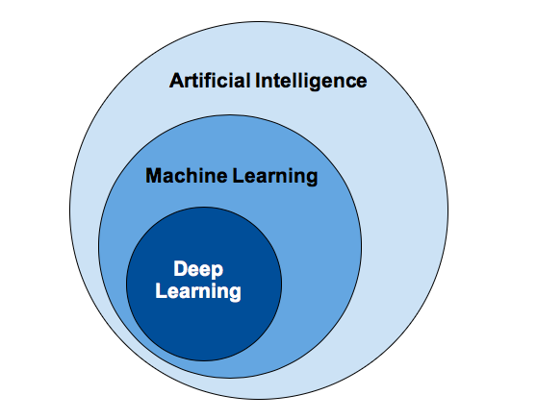
Concepts
Image Credit: https://www.sumologic.com/blog/machine-learning-deep-learning/

Slide 6
What is (general) intelligence?
Boring textbook answer
The ability to acquire and apply knowledge and skills
Dictionary
My favorite
The ability to navigate in problem space
Siddhartha Mukherjee, Columbia

Slide 7
What is artificial intelligence?
Boring textbook answer
Intelligence demonstrated by machines
Wikipedia
My favorite
The science and engineering of making computers behave in ways that, until recently, we thought required human intelligence.
Andrew Moore, CMU

Slide 8
What is machine learning?
My favorite
Study of algorithms that
improve their performance (P)
at some task (T)
with experience (E)
Tom Mitchell, CMU

Slide 9
So what is Deep (Machine) Learning?
Representation Learning
Neural Networks
Deep Unsupervised/Reinforcement/Structured/ <insert-qualifier-here> Learning
Simply: Deep Learning

Slide 10
Deep Learning Applications and Popularity

Slide 11
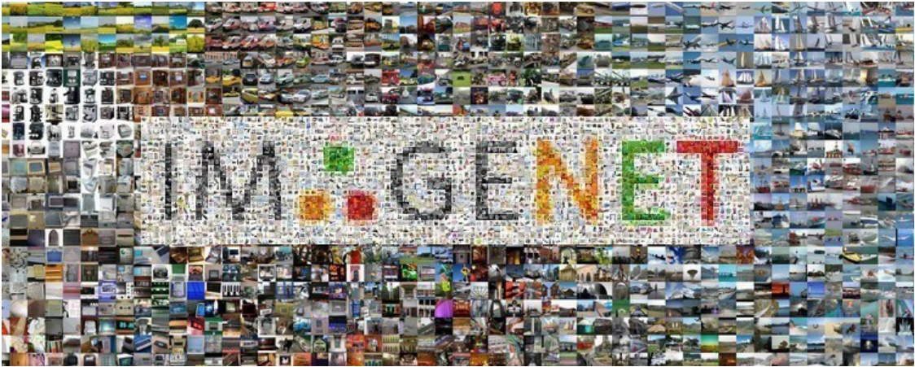
Classify Images
http://www.image-net.org/

Slide 12
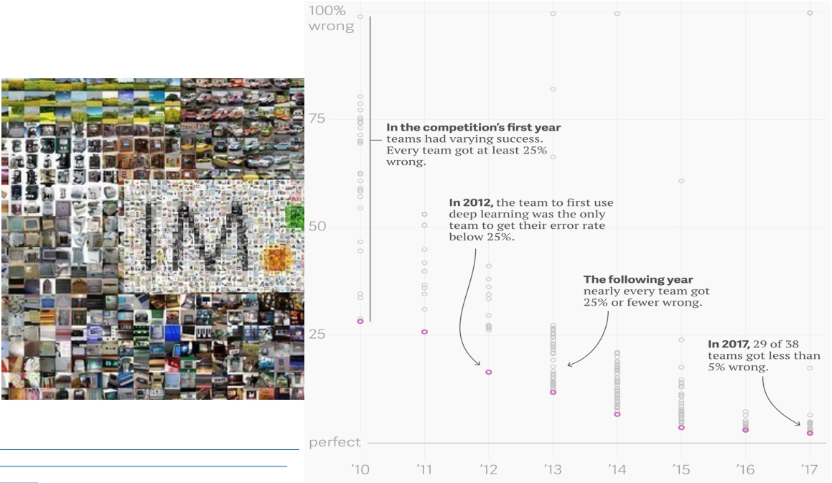
Classify Images
Yanofsky, Quartz https://qz.com/1034972/the-data-that-changed- the-direction-of-ai-research-and-possibly-the- world/
http://www.image-net.org/

Slide 13
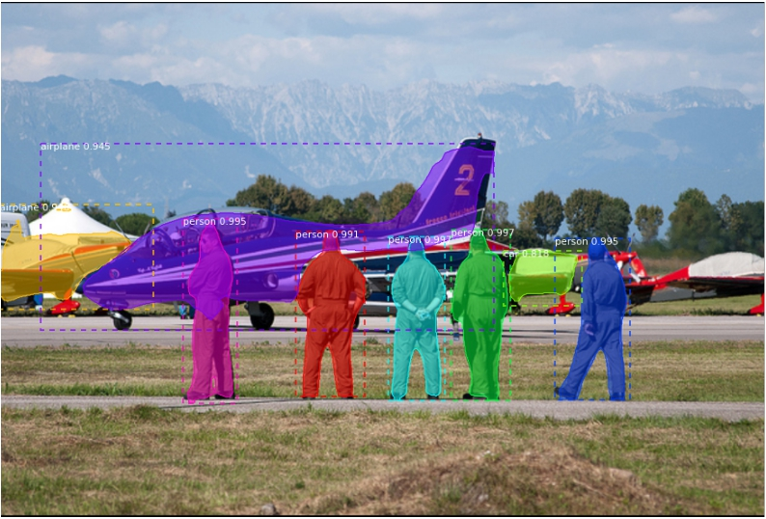
Detect and Segment Objects
https://github.com/matterport/Mask_RCNN

Slide 14
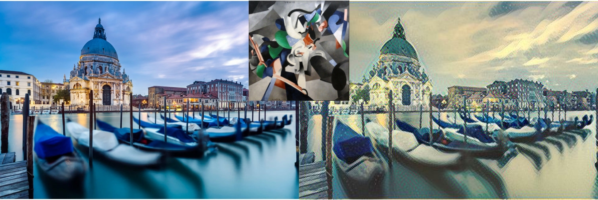
Style transfer
https://github.com/zhanghang1989/MXNet-Gluon-Style-Transfer/

Slide 15
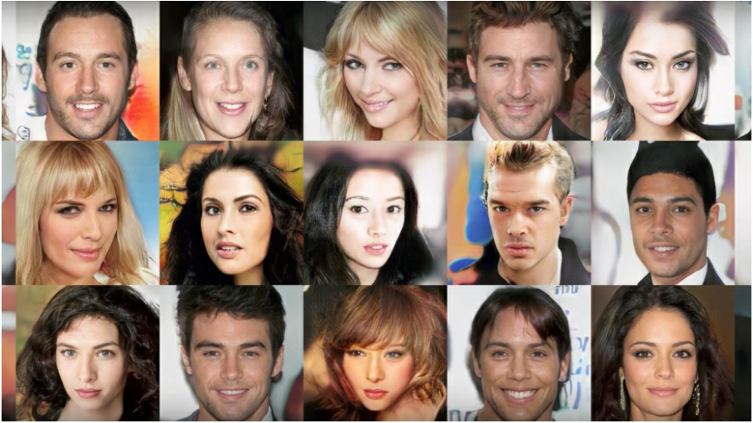
Synthesize Faces
Karras et al, ICLR 2018

Slide 16


Deep Learning: State of the Art*
(Breakthrough Developments in 2017 & 2018)
BERT and Natural Language Processing
Tesla Autopilot Hardware v2+: Neural Networks at Scale
AdaNet: AutoML with Ensembles
AutoAugment: Deep RL Data Augmentation
Training Deep Networks with Synthetic Data
Segmentation Annotation with Polygon-RNN++
DAWNBench: Training Fast and Cheap
BigGAN: State of the Art in Image Synthesis
Video-to-Video Synthesis
Semantic Segmentation
AlphaZero & OpenAI Five
Deep Learning Frameworks
* This is not a list of state-of-the-art results on main machine learning benchmark datasets. It’s an overview of exciting recent developments.
For the full list of references visit: https://hcai.mit.edu/references
https://deeplearning.mit.edu
2019

Slide 17
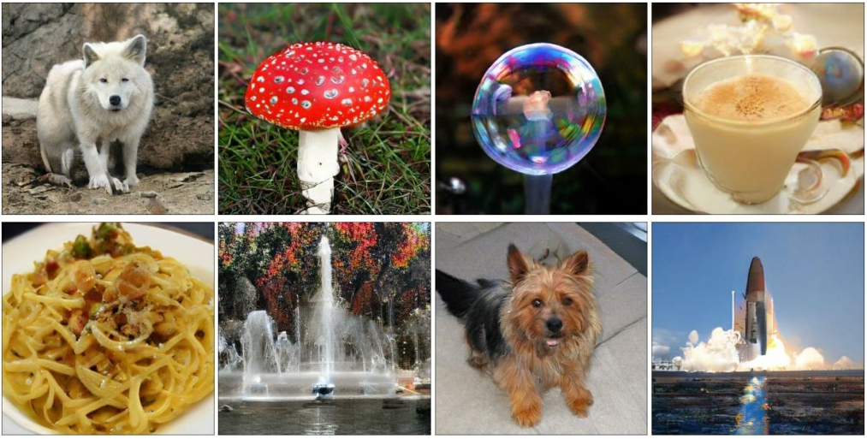


8. BigGAN: State of the Art in Image Synthesis
• Same GAN techniques, much larger scale
• Increase model capacity + increase batch size
Brock, Andrew, Jeff Donahue, and Karen Simonyan. "Large scale gan training for high fidelity natural image synthesis." (2018).
For the full list of references visit: https://hcai.mit.edu/references
[321]
https://deeplearning.mit.edu
2019

Slide 18
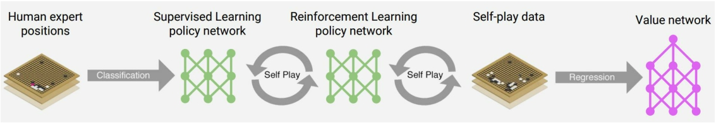
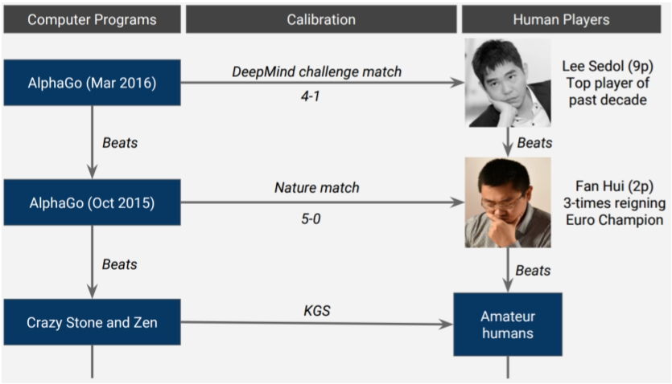
11. AlphaGo (2016): Beat Top Human at Go
For the full updated list of references visit: https://selfdrivingcars.mit.edu/references
[83]
https://deeplearning.mit.edu
2019

Slide 19
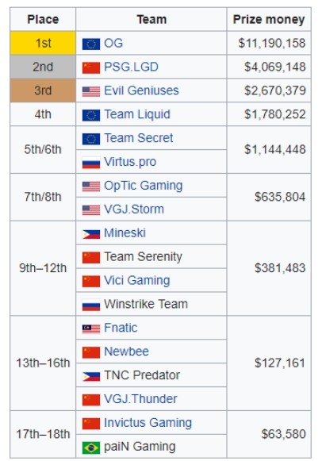
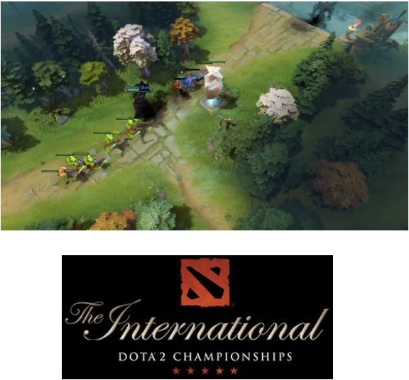
OpenAI & Dota 2
• Dota 2 as a testbed for the messiness and continuous nature of the real world: teamwork, long time horizons, and hidden information.
For the full list of references visit: https://hcai.mit.edu/references
[325]
https://deeplearning.mit.edu
2019

Slide 20
The Architecture (models) in Deep Learning

Slide 21
Perceptron, the basic block

Slide 22
Multi-layer perceptron

Slide 23
Convolutional Neural Network (CNN)

Slide 24
AlexNet (2012)

Slide 25
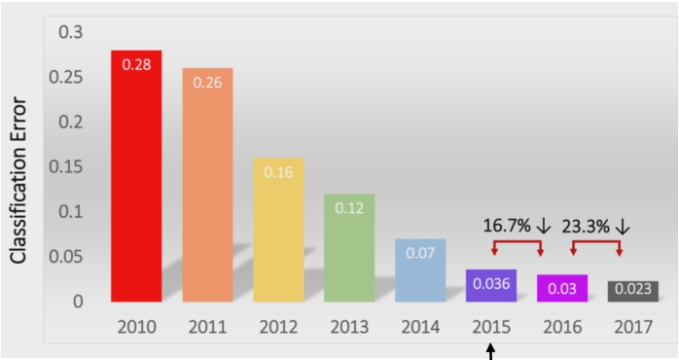
• AlexNet (2012): First CNN (15.4%)
• 8 layers
• 61 million parameters
• ZFNet (2013): 15.4% to 11.2%
• 8 layers
• More filters. Denser stride.
• VGGNet (2014): 11.2% to 7.3%
• Beautifully uniform:
3x3 conv, stride 1, pad 1, 2x2 max pool
• 16 layers
• 138 million parameters
• GoogLeNet (2014): 11.2% to 6.7%
• Inception modules
• 22 layers
• 5 million parameters
(throw away fully connected layers)
• ResNet (2015): 6.7% to 3.57%
• More layers = better performance
• 152 layers
• CUImage (2016): 3.57% to 2.99%
• Ensemble of 6 models
• SENet (2017): 2.99% to 2.251%
• Squeeze and excitation block: network
is allowed to adaptively adjust the weighting of each feature map in the convolutional block.
https://deeplearning.mit.edu 2019
Human error (5.1%)
surpassed in 2015
References: [90]

Slide 26
Depth as function of year

Slide 27
Open Source Software
As well as the common task platforms

Slide 28

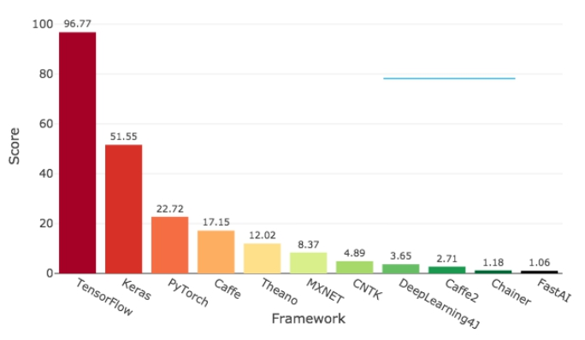
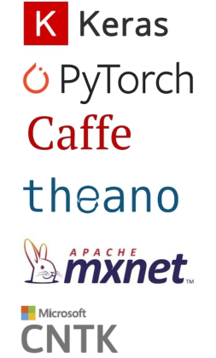
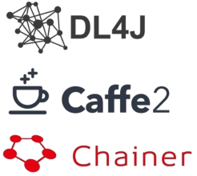

1. 2. 3. 4.
5. 6. 7.
Deep Learning Frameworks
Deep Learning Framework Power Scores (by Jeff Hale) http://bit.ly/2GBa3tU
Factors to consider:
• Learning curve
• Speed of development
• Size and passion of community
• Number of papers implemented in framework
• Likelihood of long-term growth and stability
• Ecosystem of tooling
8.
9. 10. 11.
For the full list of references visit: https://hcai.mit.edu/references
https://deeplearning.mit.edu
2019

Slide 29
Open Source Software Overview
Rating (>10) based on GitHub metrics
ArXiv:1803.04818v2 Zacharias et al.

Slide 30
Potential Benefits for Deep Learning

Slide 31
Benefits of Deep/Representation Learning
(Usually) Better Performance
Caveats: given enough data, similar train-test distributions, non-adversarial evaluation, etc., etc.
New domains without “experts”
RGBD/Lidar
Multi-spectral data
Gene-expression data
Unclear how to hand-engineer

Slide 32
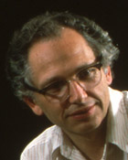
“Expert” intuitions can be misleading
“Every time I fire a linguist, the performance of our speech recognition system goes up”
Fred Jelinik, IBM ’98
“Because gradient descent is better than you”
Yann LeCun, CVPR ‘13

Slide 33
Benefits of Deep/Representation Learning
Modularity!
Plug and play architectures!

Slide 34
Differentiable Computation Graph
Any DAG of differentialble modules is allowed!
Slide Credit: Marc'Aurelio Ranzato

Slide 35
Coverage of this One-Day Short Course

Slide 36
What is this class about?
Introduction to Deep Learning
Goal:
After finishing this class, you should be ready to get started on your first DL research project.
NNs
CNNs
Target Audience:
Who wants to know what Deep Learning is

Slide 37
What this class is NOT
NOT the target audience:
People looking to understand latest and greatest cutting-edge research (e.g., GANs, AlphaGo, etc)
NOT the goal:
Teaching a toolkit. “Intro to TensorFlow/PyTorch”
Intro to Machine Learning

Slide 38
Prerequisites of this Short Course

Slide 39
Prerequisites
Intro Machine Learning
Classifiers, regressors, loss functions, MLE, MAP
Linear Algebra
Matrix multiplication, eigenvalues, positive semi-definiteness…
Calculus
Multi-variate gradients, hessians, jacobians…
Programming!
will use Python!
Anaconda
Jupyter Notebook
Libraries/Frameworks: PyTorch

